Slide 1
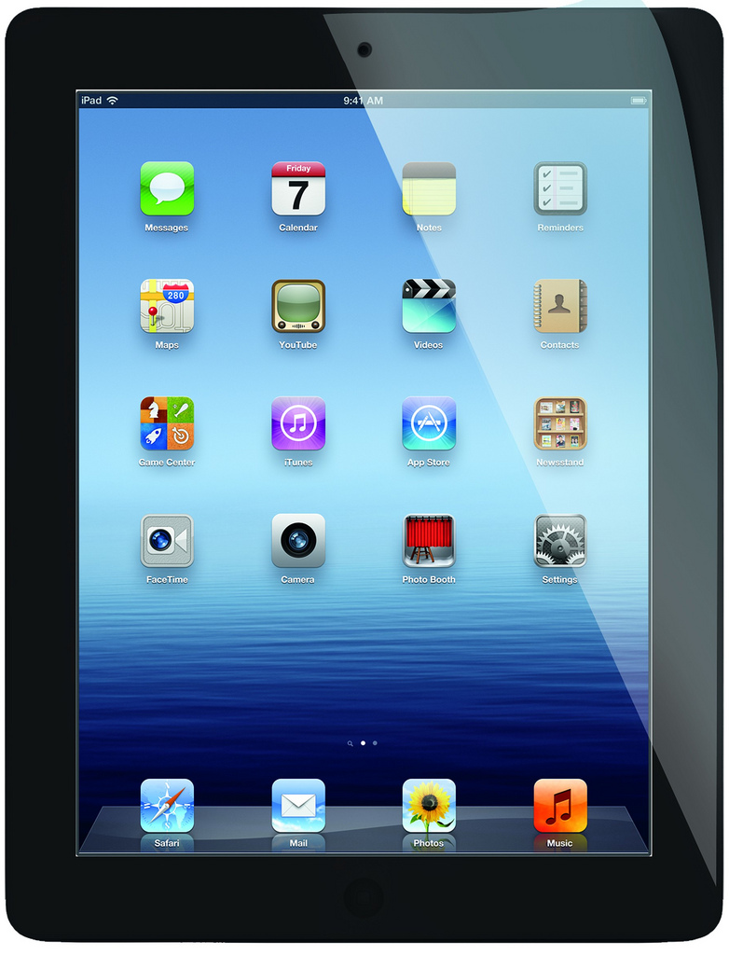
What are the best ways to incorporate technology into the classroom and are these methods effective?
By: Stephanie Dunford

Slide 2
Minds On

Slide 3
Action
Wonderings/Brainstorming/Thinking:
What happens when schools do not have a lot of funding?
Does technology waste more time during class rather than help?(when technology does not work right)
What technology is best when considering differentiation within the classroom, as well as different learning needs?
How do teachers ensure students are staying on track and not being distracted from various alternative apps and websites?
How can technology become routine in the classroom?

Slide 4
“While students may be surrounded by technology at home, it is dangerous to assume that they know how to use it for learning” (myth of the digital native)
Most students still need a guide to help them use digital tools effectively for learning and collaboration.

Slide 5
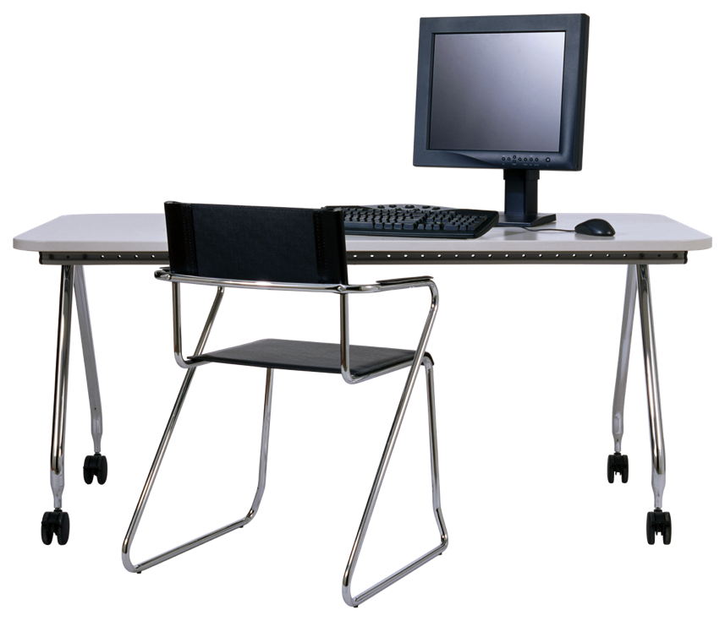
Action
Investigation/Exploration/Discovery
Students
Students are fully engaged with the use of ipads, smartboards, and computers.
It seems to be difficult ensuring every student is on track (eg. literacy game during literacy) and not playing games that do not include learning.
Use of interactive attendance app on the smartboard each day. Eg. Students were to drag their name (on a duck) to the pond
Students are always asking and wanting to use ipad, computer and smartboard
Able to take control of own learning (student centered)

Slide 6
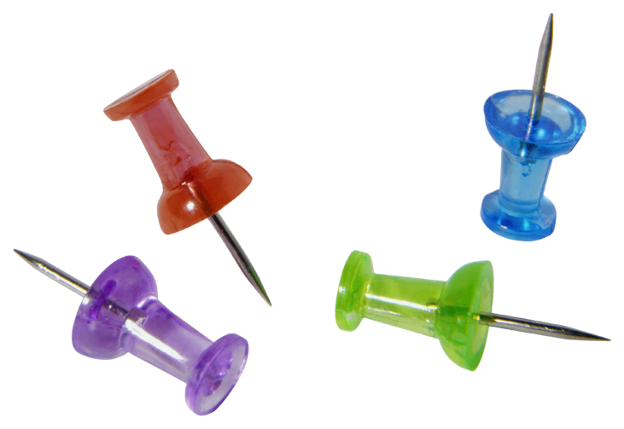
Students Continued
Enhances the relationship between teacher and student
Provide each classroom with more interesting, diverse, and current learning materials
Web connects students to experts in the real world and provides numerous opportunities for understanding through images, sound, and text.
Students are more likely to stay engaged and on task, reducing behavioral problems in the classroom.

Slide 7
Teachers
Teacher needs to always be circulating the room, ensuring all students are on task. Finding apps that are fun and engaging to make students WANT to play the correct games.
A lot of teachers shy away from technology because they have not learned how it works
There is a lot of media rules (eg. media consent, scared to accidently send a student’s work to the wrong parent)
Schools must have apps approved before using (Digital Tool Process (DTAP) and submit Digital tool permission letter to parents

Slide 8
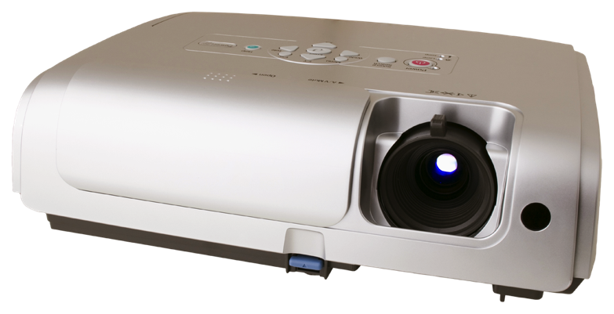
Teachers Continued
Educators need to stay current with changing technology
Having back up plan incase of technology failing
Use media that teacher is comfortable with
Model troubleshooting for students
Using technology of feedback/assessment (quick checks and personalized feedback)
Taking small steps, risk taking, open minded, careful planning
Ipads are used to take pictures of students during inquiry/centers. The teacher has a individual folder for each student on google folders.

Slide 9
Video Streaming
Wordle
Computer
Social Media
SeeSaw
Near Pod
Prodigy
Movie Maker
Youtube
Collaborative Exercises
Cube For Teachers
GoNoodle
Newsforkids
.com
BYOD
Chrome Books
Helpful Resources for the classroom
ABCYA
Smartboard
Ipads
Creating Magazine Covers
Toondoo
BrainPop
Kahoot
Twitter
Blogging
Plickers
Podcasts
Classlab.
com
Notes:
Nearpod
Students input info and teacher controls screen/receives student answers
Placement: one computer, one smartboard, and 6 ipads available.
Classlab.com
Students are able to interact with smartboard using ipads
Ipads are normally only available during centers
Depends on access and who is using the technology
Interactive websites, whiteboard activities, online videos, virtual manipulatives, native software, videoconferencing (Skype), class blog, voicethread, livebinder, google site, screencasts, moodle, create cartoons (ToonDoo), Notes
Ipad Airwatch Workshop
Classlab.com
Students are able to interact with smartboard using ipads
Multiple choice quiz
Techang.edublogs.org/2011/08/21/loaded-and-ready-to-roll/
Distribution:
Ipads- Kindergarten- Grade 3
Chrome books- Grade 4 and up

Slide 10
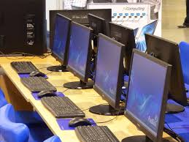
Consolidation
Technology touches every part of our lives ( in the community, school, homes etc)
Help students acquire the skills they need to survive in a complex, highly technological knowledge-based economy.
Student education must support four key components of learning: active engagement, participation in groups, frequent interaction and feedback, and connection to the real-world
Use of technology should be regularly consistent and transparent to allow students to know exactly how to utilize these essential tools for our daily lives.

Slide 11
Websites Used
http://www.edutopia.org/technology-integration-guide-implementation
https://www.youtube.com/watch?v=nA1Aqp0sPQo
http://www.edutopia.org/technology-integration-introduction
Most of the information was learned through experimentation and observation in the SK/Grade 1 classroom at WJ Watson

