Slide 1
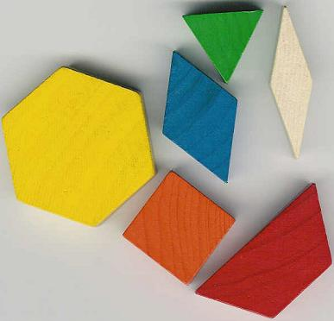
Patterning Blocks
By Stephanie Harris and Stephanie Dunford

Slide 2
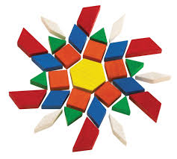
What are Patterning Blocks?
Developed in 1960s
Allows students to decompose shapes
Learning about shapes, patterning, fractions, angles and more
The lengths of the shapes’ sides are all the same (except for the trapezoid)
The top and bottom of all blocks are geometric shapes
Includes
Green triangles
Orange squares
Tan rhombuses
Larger blue rhombuses
Red trapezoids
Yellow hexagons

Slide 3
Connections with the curriculum
Patterning and algebra is the mathematics strand that investigates relationships and patterns
Students are expected to “recognize, describe, and generalize patterns and to build mathematical models to simulate the behaviour of real-world phenomena that exhibit observable patterns” (Ontario Math Curriculum)
Primary Grades
Junior Grades
- Detect patterns, designs, and movement in shapes as well as in numbers
- Investigating patterns that repeat, grow, and shrink and find ways to extend them
-Students investigate through activities how patterns change
- Begin to develop an understanding of variables as changing numbers and patterns

Slide 4
Connections with the Curriculum
Activity One
Grade two:
Overall: Read, represent, compare, and order whole numbers to 100, and use concrete materials to represent fractions and money amounts to 100Cents
Specific: compare fractions using concrete materials, without using standard fractional notation (e.g., use fraction pieces to show that three fourths are bigger than one half, but smaller than one whole);
Activity Two
Grade 4:
Overall: identify quadrilaterals and three-dimensional figures and classify them by their geometric properties, and compare various angles to benchmarks
Specific: Draw the lines of symmetry of two-dimensional shapes, through investigation using a variety of tools (eg., Mira, grid paper) and strategies (eg., paper folding)

Slide 5
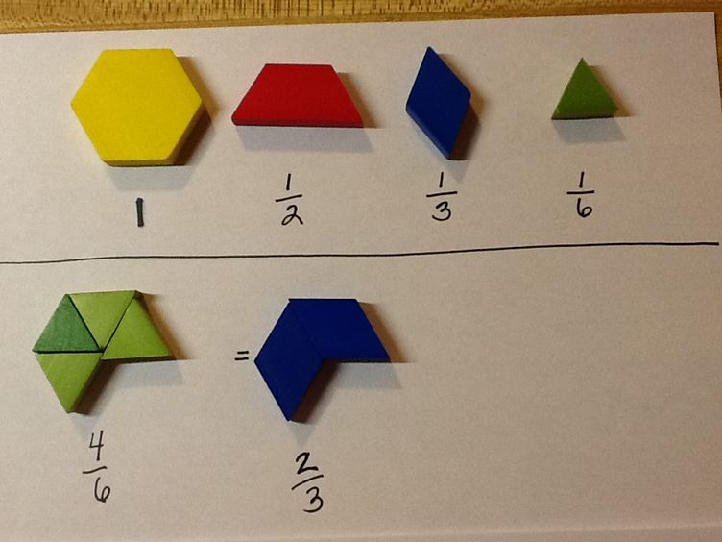
Activity One
-Each student is given a few patterning blocks at a time and are asked to determine the value of each piece, hinting that the hexagon equals one
-Students will consider this information to find as many equivalent fractions as possible
-This activity is great for all levels of students: students are able to choose a piece and sort out what other pieces fit “on top” of it.
Notes:
http://theideagal.blogspot.ca/2013/04/pattern-blocks-equivalent-fractions.html

Slide 6
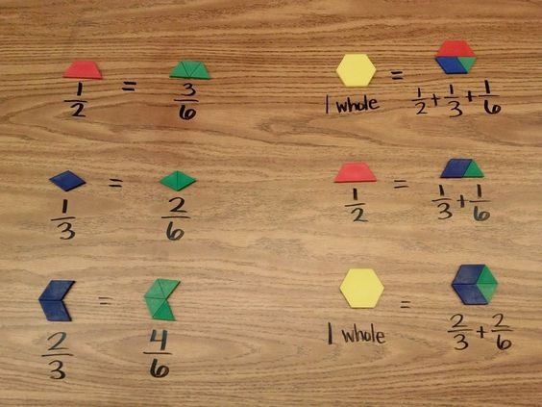
Activity One continued
-It is also a great way for students to think deeper when mixing fraction combinations
- When students are comfortable, they can begin to add fractions together

Slide 7
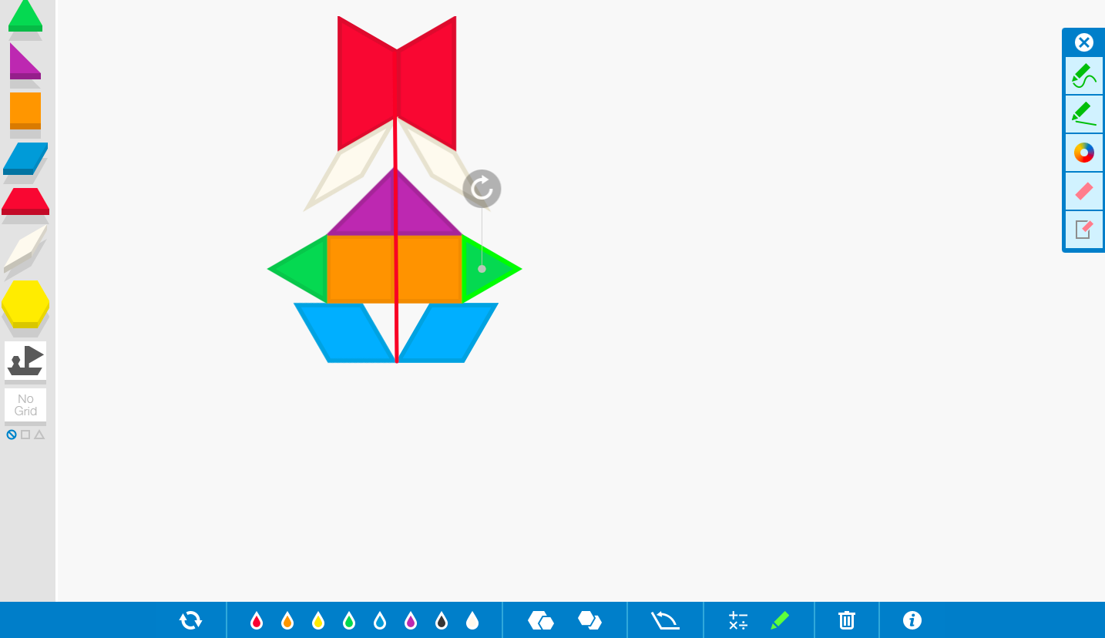
Activity Two
Students will be introduced to the App/Website called, The Math Learning Centre.
Students can create a symmetry line or will be given half of the line to show their understanding of how to turn,flip, and slide their shapes to create a symmetrical view.
Accessible and free virtual manipulative
Virtual manipulatives: “digital versions of the concrete materials found in the classrooms today including pattern blocks” (Van pg 113)
Accommodations available for special purposes

Slide 8
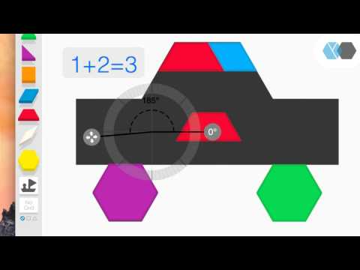
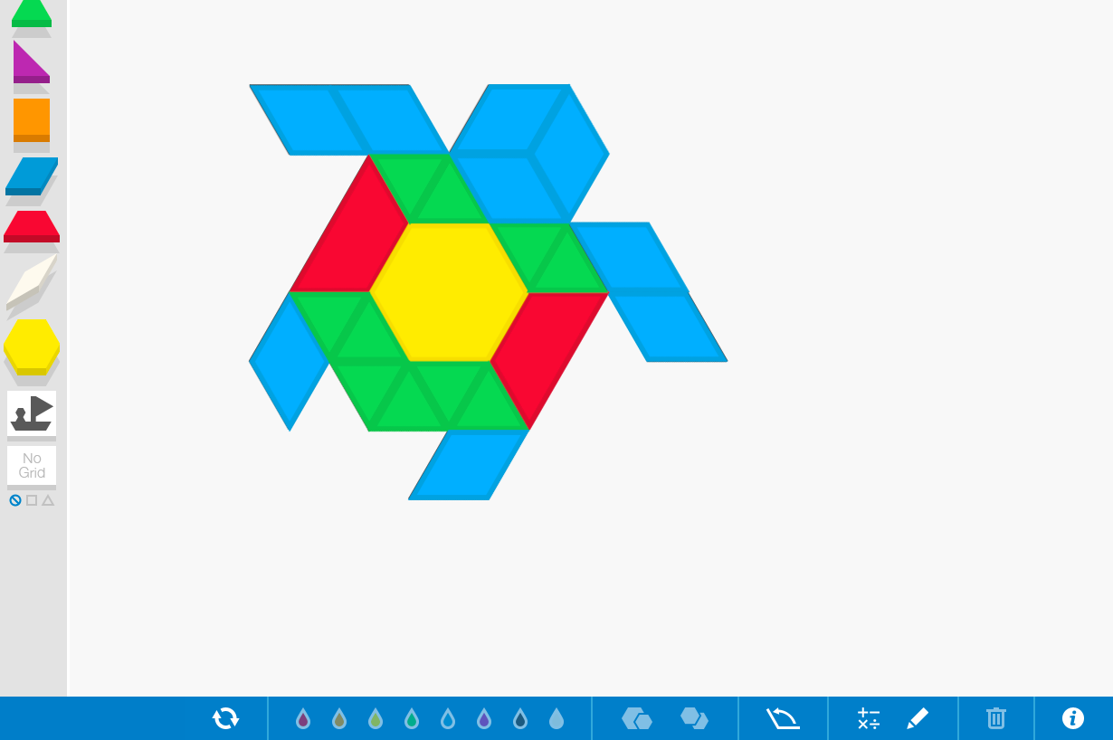
Activity Two Continued
Students will investigate, explore, and compare the differences in using 2D patterning blocks to create objects and animal shapes.
This App/Website is one tool students can use to help in understanding geometric properties of each shape.
We want you to now open up your computers to try it out with the line of symmetry we created! (An idea?)
(Going to add something else here)

Slide 9
How do patterning blocks help students?
Able to explore many relationships such as fractions, angles, transformations, patterning, measurement, symmetry etc.
Once students have an understanding through a hands on experience using patterning blocks, they will have a better understanding on how to recognize patterns
Students that struggle are able to fall back and use pattern blocks to assist them when solving problems.
Through the observation of different representations of a pattern, students begin to identify some of the properties of the pattern.
Manipulatives such as patterning blocks help students create patterns and recognize relationships.

Slide 10
Connection to Research
Van de Walle
Tangible items are normally involved in both elementary and middle years classrooms
Can be used for many subjects and content areas
Patterning blocks are an alternative way of “seeing” a mathematical idea or concept
Manipulatives help gain confidence and understanding
Notes:
Pg 107

Slide 11
Connection to research
Articles:
Current curriculum reform efforts and research in learning contend that observations of patterns and relationships lie at the heart of acquiring deep understanding in many areas of mathematics—algebra and function in particular (Steen 1988).
K-2: Students begin to sort through patterns looking specifically at colours.
3-4: Students also look at patterns but begin to notice the variables within the equation or question.
5-6: Students begin to use new ways of looking at the equation or question through; graphs, tables,critical questions to expand the problem

Slide 12
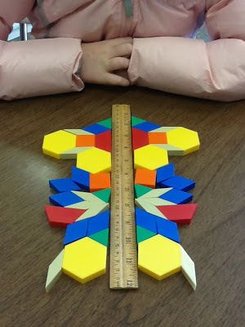
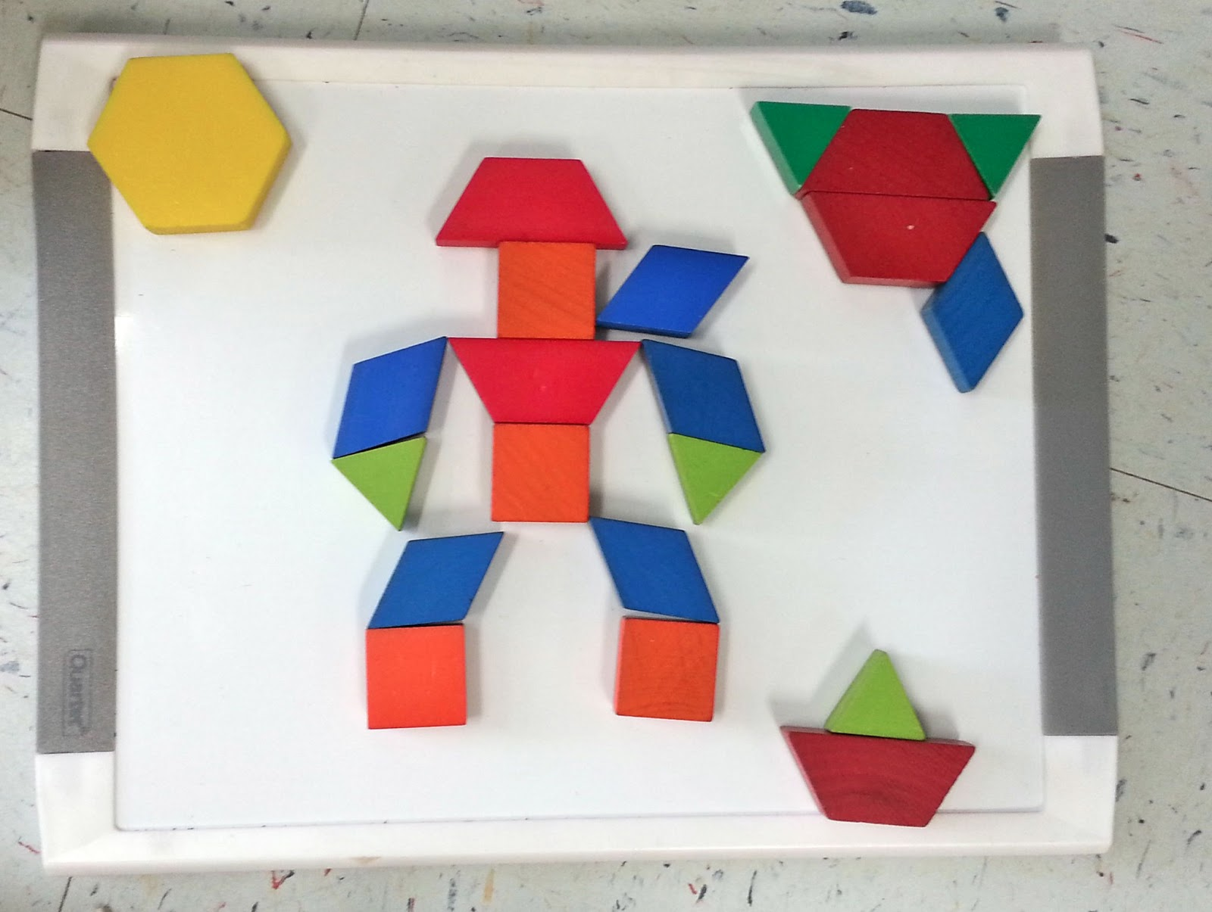
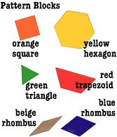
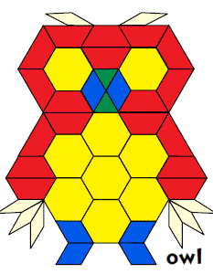
Cross Curricular Connections
Art (symmetry)
Aboriginal Studies
Literacy (spelling)
Science (animals)

Slide 13
Extra Activities
How many different ways can you name the orange (square) piece?
2. How many different ways can you cover the hexagon with other shapes?
3. Use exactly three blocks to make a pentagon. How many different ways can you do this? What is the sum of the interior angles in each case?
4. Design a tessellating floor pattern.
5. How many lines of symmetry are there for each piece?
6. Create a symmetrical design. Describe the design to a partner.
7. Let “a” represent the area of a hexagon. Determine a representation for the area of each other piece.
8. Create a shape with three or more pattern blocks. Choose a variable to represent the area of each piece in
9. the shape. Create an expression for the total area. Make several copies of the shape. Create an algebraic expression for the total area of all of the shapes.

Slide 14
Extra Activities Continued
Build a shape with a perimeter of 10 and an area of 5.
Design a sequence of patterns. Analyze the pattern and determine an attribute of the 100th term in the sequence.
Put a variety of pieces into a paper bag. Determine the probability of choosing one type of piece.
Let “a” represent the area of a hexagon. Determine a representation for the area of each other piece.
Create a shape with three or more pattern blocks. Choose a variable to represent the area of each piece in the shape.
Create an expression for the total area. Make several copies of the shape. Create an algebraic expression for the total area of all of the shapes.

Slide 15
Further Resources
Gonzalez-Granat, Olga. "Pattern Block Patterns and Shapes." (2015): 1-32. Learning Resources. Web.
Nichole. "2D Shape Pattern Block Challenge Cards." You Clever Monkey. Nichole, n.d. Web. 31 Oct. 2016.
Kirsten, Ms. "Pattern Blocks: Equivalent Fractions." Idea Gal:. N.p., 01 Jan. 1970. Web. 31 Oct. 2016.
Steen, Lynn Arthur. “The Science of Patterns.” Science 240 (29 April 1988): 611–16.
Van de Walle, John., Karp, Karen., Bay-Williams, Jennifer., McGarvey, Lynn., Folk.,
Sandra. (2015). Elementary and Middle School Mathematics Teaching Developmentally. Toronto: Pearson.
Ministry of Education. The Ontario Curriculum: Grades 1-8. Mathematics, 2015
Apps to creating patterns:
http://www.mathplayground.com/patternblocks.html
http://www.mathlearningcenter.org/wed-apps/pattern-shapes/

